Slide 1
Horror Fiction
Writer’s Workshop #2
ELA 30

Slide 2
What is it?
Highly improbable and unexpected chain of events.
Begins with everyday, ordinary situations and then takes a turn…
Mood is dark, menacing, and draws the reader in.
Told in the third person (not “I” or “me”)
In the end, horror fiction deals with a protagonist fighting against overwhelming and dark forces.

Slide 3
5 keys to writing horror stories
Foreshadowing
Fear
Mystery
Suspense
Imagination/Surprise

Slide 4
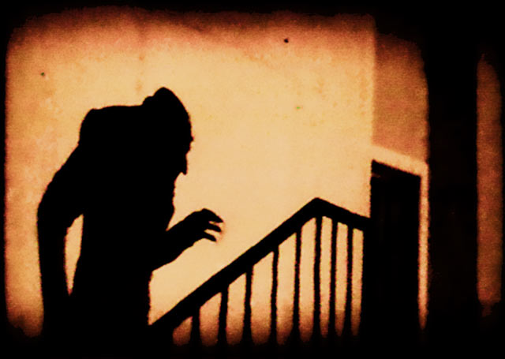
Foreshadowing
An indication of future events that builds anticipation.
Sprinkling of bread crumbs throughout the story to prepare the reader for the impact of the climax or conclusion.
It can be small, slipped right in – reader might think it’s unintentional.
Reader will be able to piece together the foreshadowing after the conclusion of the story.

Slide 5
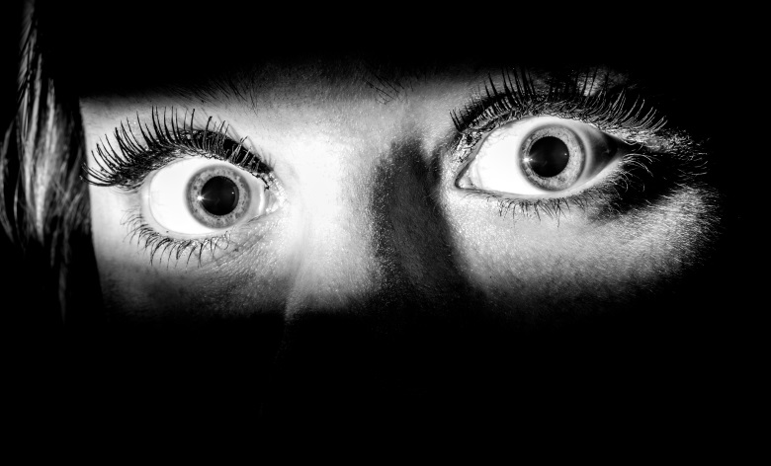
Fear
Most important part of a great horror story!
The story needs to elicit fear in the reader.
Make the fear relatable – take a topic and really focus on making it terrifying for everyone (spiders, darkness, etc.)
Spin the element of fear into everyday, ordinary things to be effective.

Slide 6
Mystery
Adds reliable and believable surprise to a story.
Don’t give all the details away!
Make sure your reader is questioning how this story is going to end.

Slide 7
Suspense
Without suspense, your reader is on a roller coaster that spikes with fear and then immediately becomes boring.
Keeps the reader on the edge of their seat.
Drag out your character’s fear with suspense – this will drag the reader along with it!
At the end of a long suspense, comes the surprises!

Slide 8
Imagination/Surprise
Use your imagination to toy with your reader – you don’t want them to expect what is coming next.
Surprise after surprise is meaningless, make it worth it!
The whole idea is to get the reader to imagine themselves as the character. This is where fear really sets in.

Slide 9
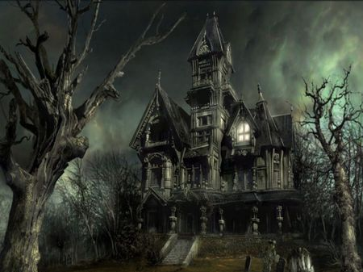
Your 2nd Writer’s Workshop Assignment
1 – Go over Horror Fiction together (today)
2 – Pick topic, begin drafting
3 – Drafting
4 – Finish drafting, Peer Edit
5 – Typing, Hand In
40 marks
5 point rubric will be used

