Slide 1
Pablo Picasso
Blue Period

Slide 2
Pablo Picasso Blue Period Background
1901 – 1904
Monochromatic paintings in shades of blue and blue-green
Inspired by Spain but painted in Paris
Inspired by the death of his close friend
Deals with sad subject matter
Had trouble selling them after creating them. Now it is his most popular period.

Slide 3
Sketch the following Paintings:
Add words that describe what you see: colours, feelings, moods, subject, etc.

Slide 4
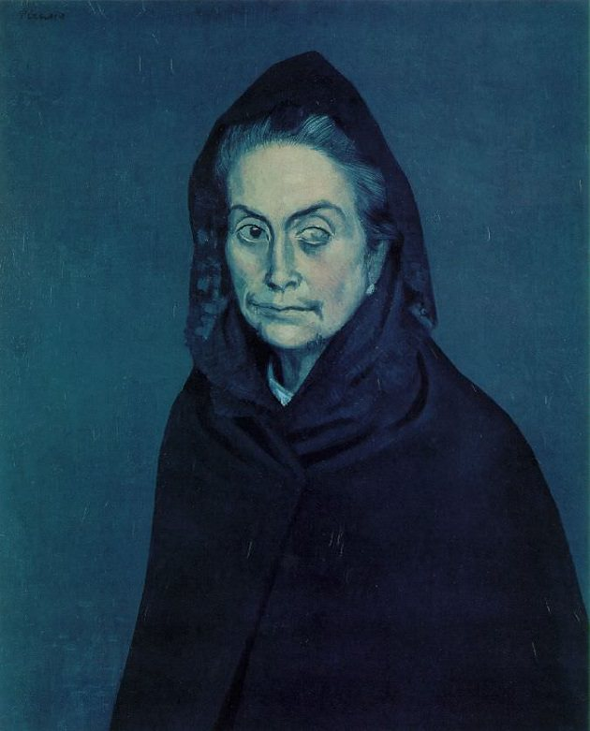
Celestina

Slide 5
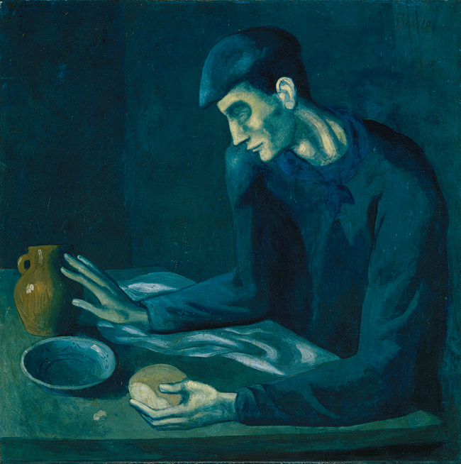
Blindman’s Meal

Slide 6
La Soupe

Slide 7
YOUR ASSIGNMENT!
Posterized Monochromatic Portraits

Slide 8
Posterized Monochromatic Portraits
Tone – the lightness or darkness of a colour
Posterized – an image that uses a SMALL amount of different tones.
Monochromatic – different tones from the SAME colour (only reds, only blues, only greens, etc.)

Slide 9
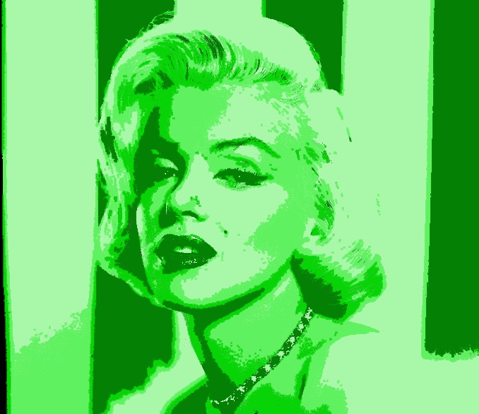
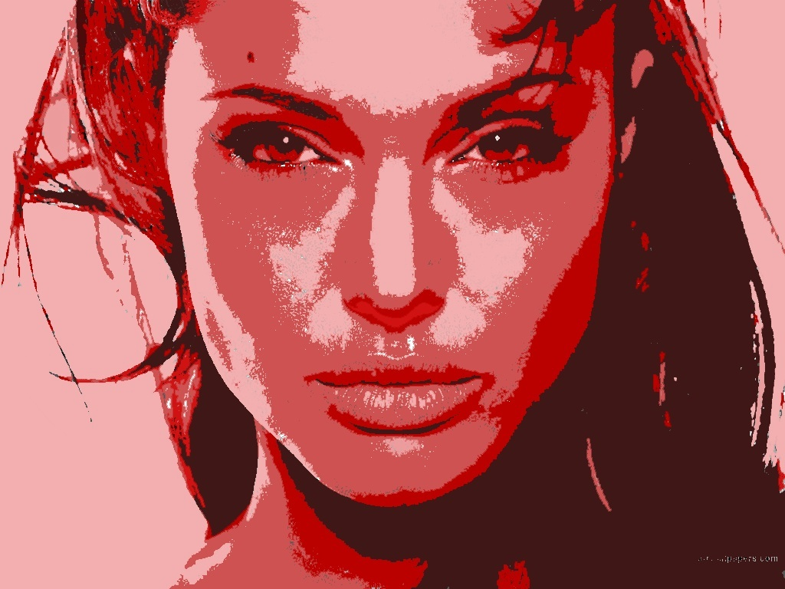
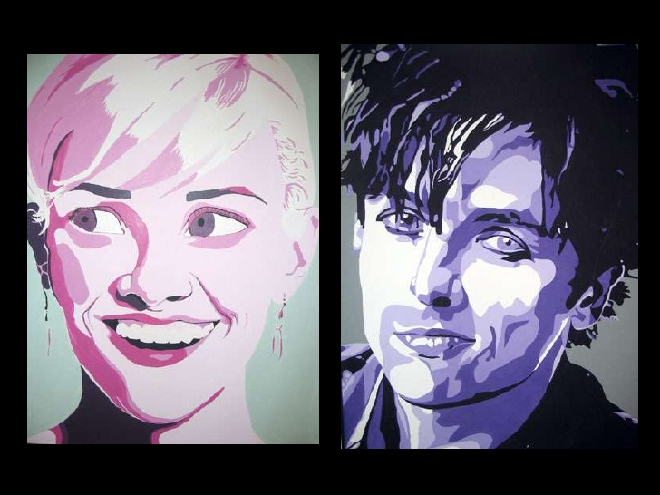
EXAMPLES:

Slide 10
What’s your job?
Decide on a famous portrait to use. Or yourself. Or your friend. But has to be a face!
You will go to https://www.imgonline.com.ua/eng/posterization.php to posterize your picture. Must be black and white.
Print a copy. Save to Mrs. L’s USB.
You will use the projector to trace your image onto your project paper.

Slide 11
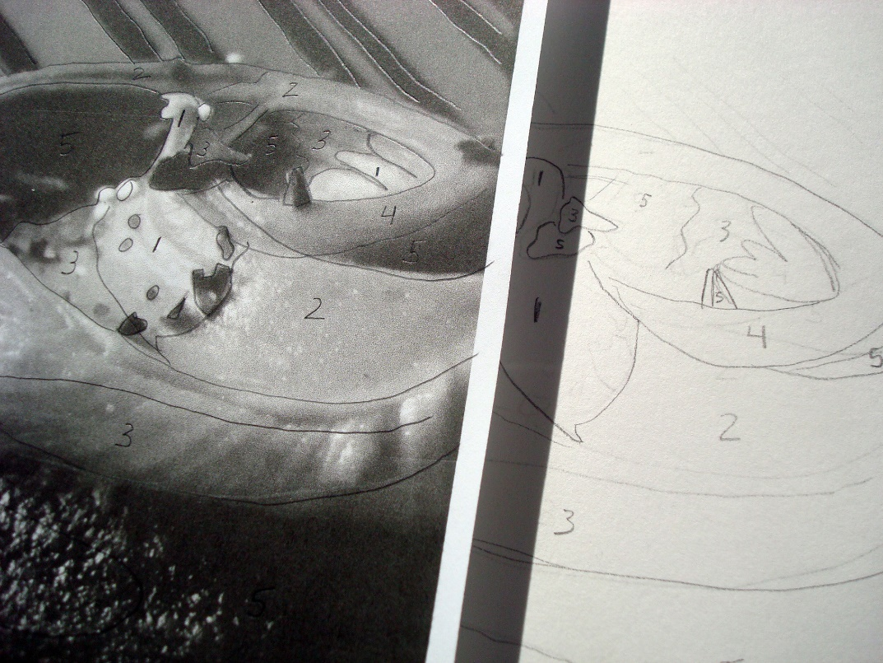
How to create the monochromatic look:
You will create a palette of your colour of choice. Remember: it must all be the same colours, just different tones. Add White, add Black!
Label each section of your traced drawing – 1 is the lightest and work your way up.

Slide 12
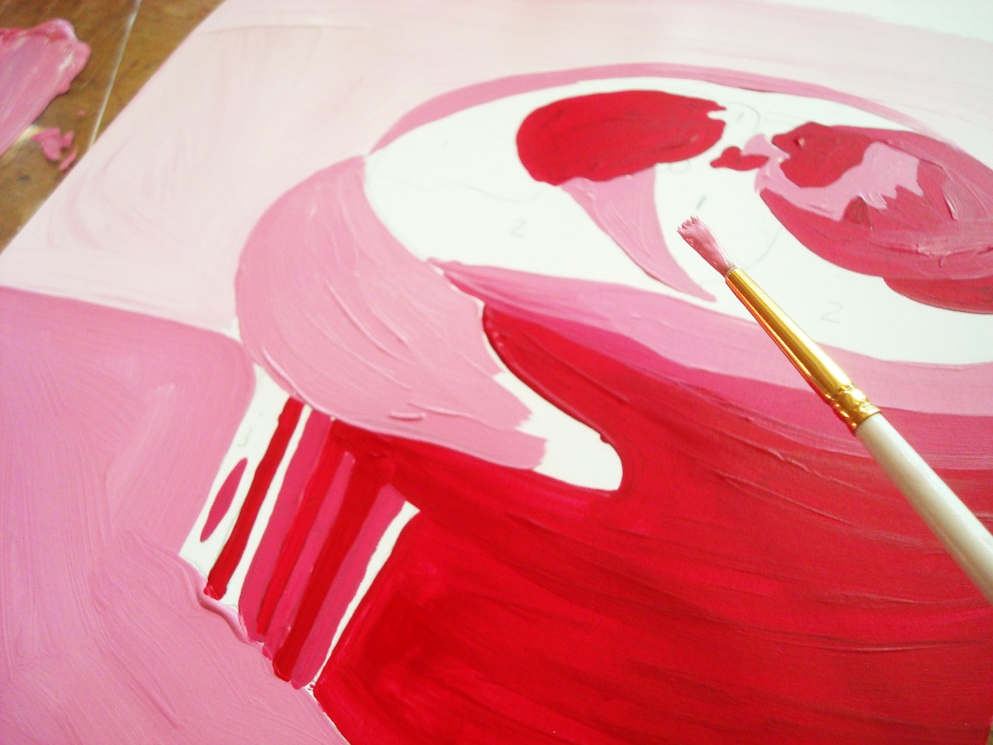
Once you have labelled each section for your tones:
Paint each section, one a at a time. Stick to the same tone – ie. If you start with section 4, paint ALL of the sections that are labelled 4 on your traced portrait.

Slide 13
THE END
You should have roughly 8 different tones present in your artwork at the end. These will create the lighting and shadows in order to make it look like the actual person!

